Slide 1
False Discovery Rate in Large-Scale Data Error Localization: Examining Survey Editing Methods’ Performance
Chin-Fang Weng: U.S. Census Bureau (Retired)
Paul J. Smith: University of Maryland, College Park (Retired)
Eric V. Slud: U.S. Census Bureau &
University of Maryland, College Park

Slide 2
Survey Data Editing & Data Editing Effect
Survey Data Editing: a method to handle reporting or recording errors, which degrade the survey data quality and may lead to incorrect inferences (De Waal et al., 2011; NAS 2018).
Potential Editing Effects
Source: Synthetic data resembling real world occupational survey data.
 | Data before Editing |  | Data after Editing
Occupation | Est. Total | CV (%) | Est. Total | CV (%)
A | 227,000,652,590 | 100.2 | 431,962 | 9.3
B | 142,556 | 65.4 | 51,664 | 17.4
C | 293,742 | 43.9 | 148,417 | 10.0
D | 10,100,310,701 | 99.2 | 216,622 | 6.6

Slide 3
Editing Process & Editing Errors
Step I - Error Localization: The process of detecting potential errors. Editing errors occur when incorrectly flagging observations, i.e., type I error & type II error.
Step II - Error Value Replacement (item Imputation): The process of replacing erroneous values with corrected values. Editing errors occur when imputing values for flagged observations, i.e., imputation bias.
Editing methods are similar to outlier detecting techniques or regression. Editing methods for periodic surveys use prior year data as predictor and assume it has no errors. This strong assumption may not always hold.

Slide 4
False Discovery Rate to Assess Editing Methods
- Editing is a multiple hypothesis testing problem with one test for each observation.
FDR is the expected proportion of Type I errors among observations flagged as errors (Benjamini & Hochberg 1995, Efron 2010).
Controlling FDR is an alternative to the Bonferroni adjustment for controlling Type I error in multiple testing.
 |  | Predicted Class
 |  | Errors | Correct Values
Actual Class | Errors | TP | FN (Type II error) | TP/ (TP + FN) = Sensitivity
 | Correct Values | FP (Type I error) | TN | TN/ (FP + TN) = Specificity
 |  | FP/ (TP + FP) = FDR

Slide 5
Research Interests
Simulation approach – simulate various data scenarios.
- Focus - error localization step in quantitative periodic surveys.
Selective editing methods - Identify large data errors only (Granquist et al., 1997. Norberg, 2016)
Research questions:
What is the FDR of the editing methods on varying data scenarios?
What is the Total Bias Reduction of the editing methods?
Experimental study of a new editing method.

Slide 6
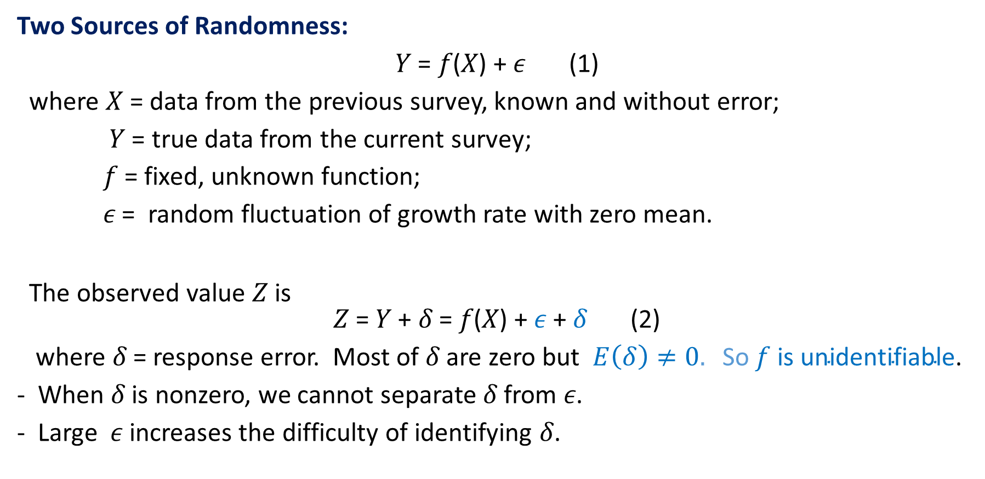
The Challenge of Editing a Periodic Survey
Two Sources of Randomness:
𝑌 = 𝑓(𝑋) + 𝜖 (1)
where 𝑋 = data from the previous survey, known and without error;
𝑌 = true data from the current survey;
𝑓 = fixed, unknown function;
𝜖 = random fluctuation of growth rate with zero mean.
The observed value 𝑍 is
𝑍 = 𝑌 + 𝛿 = 𝑓(𝑋) + 𝜖 + 𝛿 (2)
where 𝛿 = response error. Most of 𝛿 are zero but $E\left(δ\right)≠0. \text{So} \text{f} \text{is} \text{unidentifiable}\text{.}$
When 𝛿 is nonzero, we cannot separate 𝛿 from 𝜖.
Large 𝜖 increases the difficulty of identifying 𝛿.

Slide 7
Simulation I: Editing Methods and Data Scenarios
Data generation: Simulated data mimics real world periodic survey.
- Let X, Y, and Z be the same variables from a periodic survey.
X, the previous period variable, free of error and observable.
Y, true values of the current variable, free of error but not observed directly.
Z, Some values of Y are distorted by errors, yielding observed data Z.
X and Y have mixed lognormal distributions, corresponding to large and small units.
Errors in Z are assigned randomly with overall probability 10%. Smaller Z values are more likely to be errors.
Generated 10000 replicated samples of triplets (X_{i}, Y_{i}, Z_{i}), i = 1,…,1000.

Slide 8
Simulation I: Editing Methods and Data Scenarios
Data Scenarios: Six data scenarios formed by combining corr(X, Y) and corr(X, Z).
corr(X, Y) = 0.95 or 0.81. Large corr(X, Y) corresponds to stable growth rates.
corr(X, Z) = 0.90, 0.73, 0.50, or 0.28. When corr(X, Z) is much less than corr(X, Y), there are frequent and/or substantial response errors.
Editing methods:
- Robust Regression (RR) (Huber, 1973):
Regresses Z on X and flags largest absolute regression residuals as errors.
Hidiroglou-Berthelot method (HB) (Hidiroglou et al., 1986):
Applies nonlinear (log like) transform g to growth rates 𝑟_{𝑖} = z_{𝑖}/x_{𝑖}.
Applies power transform t^{U} to each observed max(X_{𝑖}, 𝑍_{𝑖}) ^{U} .
Extreme values of the product (g(𝑟_{𝑖})) (max(X_{𝑖}, 𝑍_{𝑖}) ^{U}) are flagged as errors.

Slide 9
Simulation I: Results & Discussion
Data Scenario: (corr(X,Y); corr(X,Z) | # of Errors Flagged | HB |  | RR
 |  | Type I Errors | FDR | Type I Errors | FDR
1 (0.95; 0.90) | 19 | 6 | 32% | 12 | 63%
2 (0.95; 0.73) | 33 | 4 | 12% | 17 | 30%
3 (0.95; 0.50) | 42 | 4 | 10% | 21 | 50%
4 (0.81; 0.73) | 31 | 19 | 61% | 25 | 81%
5 (0.81; 0.50) | 43 | 18 | 42% | 29 | 67%
6 (0.81; 0.28) | 50 | 18 | 36% | 32 | 64%
Note: RR and HB flag equally many observations.
FDR is very unstable: For HB, 10% < FDR < 61%. For RR method 30% < FDR < 81%.
HB method is superior to RR.
The lowest FDR occurred in Scenario 3, corr(X,Y) = .95, corr(X,Z) = .50.
The highest FDR appeared in Scenario 4, corr(X,Y) = .81, corr(X, Z) = .73.

Slide 10
Simulation I: Results & Discussion
Effect of Editing Methods:
HB method is superior to RR.
RR uses original X and Z values. HB transforms the growth rate and max(X, Z) values to increase the effect size, hence increasing its statistical power.
Effect of Data Scenarios:
Scenario 3, corr(X,Y) = .95, corr(X,Z) = .50,
corr(X,Y) = .95 means smaller 𝜖, and corr(X,Z) = .50 means larger 𝜖 + 𝛿. Thus, it is easier to identify errors.
Scenario 4, corr(X, Y) = .81, corr(X, Z) = .73,
corr(X,Y) = .81 means larger 𝜖 and corr(X,Z) = .73 means the magnitude of 𝛿 is small. Thus, it is difficult to identify errors.
Scenario 4 more closely resembles real periodic survey data.

Slide 11
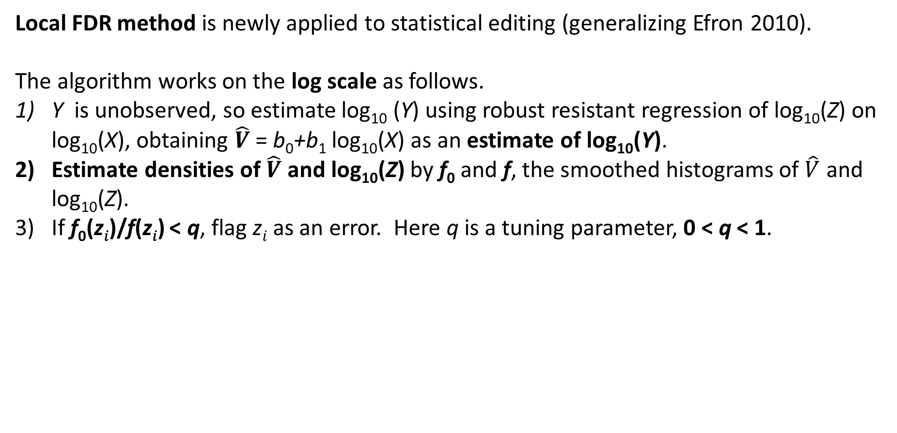
Local False Discovery Rate (Local FDR) Method
Local FDR method is newly applied to statistical editing (generalizing Efron 2010).
The algorithm works on the log scale as follows.
Y is unobserved, so estimate log₁₀ (Y) using robust resistant regression of log₁₀(Z) on log₁₀(X), obtaining $\hat{V}$= b₀+b₁ log₁₀(X) as an estimate of log₁₀(Y).
Estimate densities of $\hat{V}$ and log₁₀(Z) by f₀ and f, the smoothed histograms of $\hat{V}$ and log₁₀(Z).
If f₀(z_{𝑖})/f(z_{𝑖}) < q, flag z_{𝑖} as an error. Here q is a tuning parameter, 0 < q < 1.

Slide 12
Simulation II: Editing Methods, True Positive, False Positive
Generating Simulation Data:
2,185 publicly traded NYSE (New York Stock Exchange) yearly closing stock prices were taken.
Year 2010 was taken as X and Year 2011 was taken as Y; corr(X,Y) = 0.95.
With X and Y fixed, a random 10% of the Y values were multiplied by random lognormal errors to create 𝑍; corr(X, Z) = 0.52.
Editing methods: HB method, RR method, and Local FDR method.

Slide 13
Simulation II: Editing Methods, True Positive, False Positive
Methods | HB | RR | Local FDR
Total number of Errors | 222 | 222 | 222
Number of errors flagged | 77 | 88 | 87
False Positive | 6 | 12 | 54
True Positives | 71 | 76 | 33
FDR | 7% | 14% | 62%
Total Values of True positive | 15076 | 15842 | 12160
The table displays results for a single iteration. corr(X,Y) = .95, corr(X,Z) = .52
HB has FDR = 7%. RR has FDR = 14%. Local FDR has FDR = 62%.
The total values of true positives are 15,842 and 12,160 for RR and Local FDR, respectively.

Slide 14
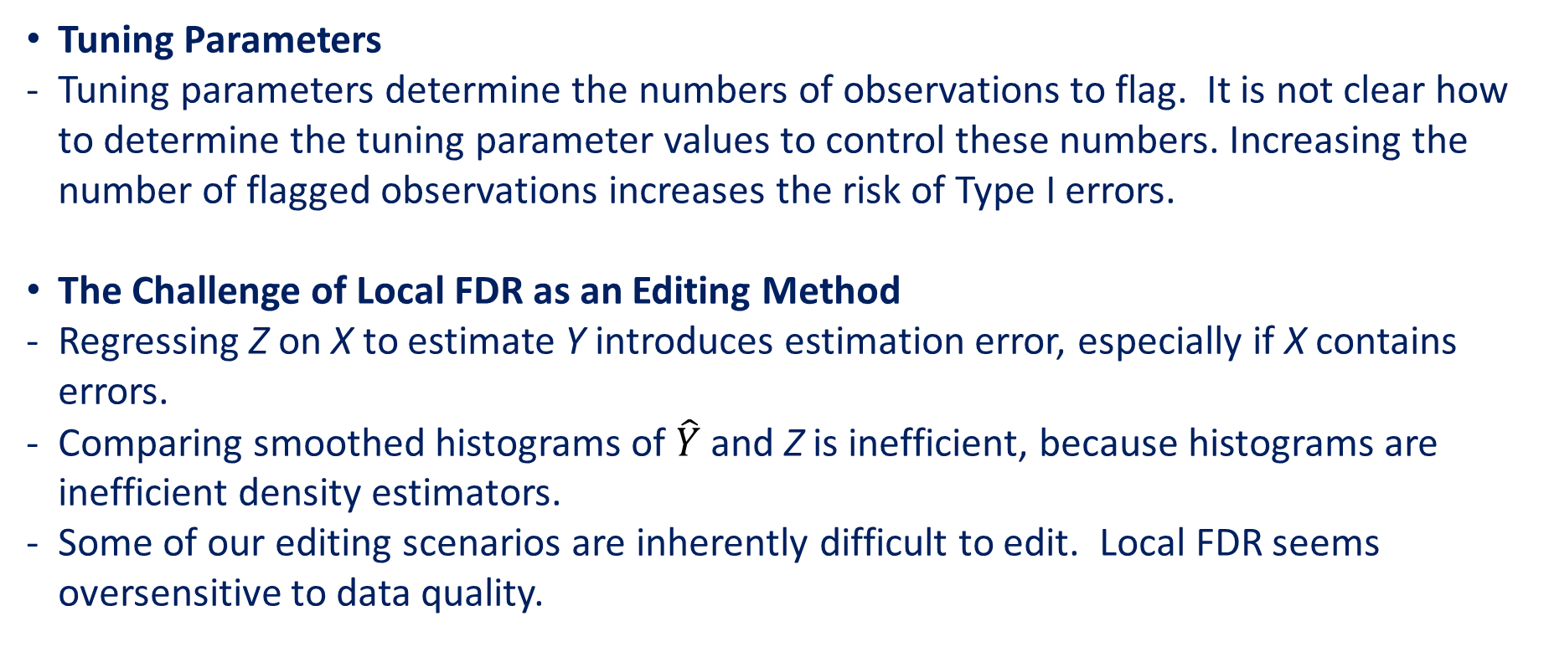
Simulation II: Results & Discussion
Tuning Parameters
Tuning parameters determine the numbers of observations to flag. It is not clear how to determine the tuning parameter values to control these numbers. Increasing the number of flagged observations increases the risk of Type I errors.
The Challenge of Local FDR as an Editing Method
Regressing Z on X to estimate Y introduces estimation error, especially if X contains errors.
Comparing smoothed histograms of $\hat{Y}$ and Z is inefficient, because histograms are inefficient density estimators.
Some of our editing scenarios are inherently difficult to edit. Local FDR seems oversensitive to data quality.

Slide 15
Simulation II: Localizing True Errors

Slide 16
Simulation II: Localizing True Errors
- Gray dots are error-free data. Note clear linear trend for error-free data.
- Black dots are unflagged errors. Errors mainly occur for small stock prices.
- The error point (378,3420) does not appear on the graphs.
- Red dots are correctly flagged errors, i.e., true positives.
- HB, RR, and Local FDR identified all outliers, that is, all errors >
500.
- HB and RR behave similarly and flag many smaller errors and inliers.
- Local FDR identifies some smaller errors in an inconsistent fashion.

Slide 17
Simulation II: Location of False Positives

Slide 18
Simulation II: Localization of False Positives
- Gray dots are error-free data,
- Black dots are errors,
- Red dots are incorrectly flagged errors, i.e., false positives.
- HB, RR, and Local FDR all committed Type I errors. But the three methods flagged different observations.
- Some Type I errors have large magnitudes. HB and RR flag points that seem far from the general linear trend. Local FDR does not seem to follow an observable pattern.
L

Slide 19
Conclusions & Future Study
Conclusions
The 3 methods flagged different numbers of data points. They also committed different numbers of Type I and Type II errors. Their performances depend on the choice of their tuning parameters and are sensitive to data scenarios.
HB is fairly robust, compared to its counterparts. Local FDR needs refinement before it is suitable for editing applications.
Future Study
It is not clear how to determine the tuning parameters of HB and local FDR to control the number of flagged data points. We will investigate the use of the ROC curve to address this problem.
We will investigate refinements to the local FDR method to improve its performance as an editing method.

Slide 20
Selected References
Rubin, D.B. (1987) Multiple Imputation for Nonresponse in Surveys. J. Wiley & Sons Inc., New York.
De Waal, T., Pannekoek, J. & Scholtus, S. (2011) Handbook of Statistical Data Editing and Imputation. J. Wiley & Sons Inc., New York.
Ghosh-Dastidar, B. & J. L. Schafer (2006) Outlier Detection and Editing Procedures for Continuous Multivariate Data. Journal of Official Statistics 22, pp.487 – 506.
Cochran, W. G. (1968) Errors of Measurement in Statistics. Technometrics 10, pp. 637-666.
Benjamini & Hochberg (1995) Controlling the False Discovery Rate: A Practical and Powerful Approach to Multiple Testing. J. Royal Statist. Soc. B 57 pp. 289-300.
Granquist, L. and J. Kovar (1997) Editing of Survey Data: How Much Is Enough? In: Survey Measurement and Process Quality, L.E. Lyberg et al., eds. J. Wiley & Sons, New York, pp. 415-435.
National Academy of Sciences, Engineering and Medicine (2018) Reengineering the Census Bureau’s Annual Economic Surveys. National Academies Press, Washington, DC,
Efron, B. (2010) Large Scale Inference. Cambridge University Press.
Norberg, A. (2016), SELEKT – A Generic Tool for Selective Editing, Journal of Official Statistics 32, pp. 209-229.

Slide 21
Thank you!
Chin-Fang Weng
cfweng7117@gmail.com

Slide 22
Simulation I: Details of Data Generation
Let X, Y and Z be the same variables from a periodic survey. We generated 10,000 replicated samples of size 1,000 as follows.
X: the previous period variable, known and free of error. X is a lognormal mixture of large and small units, 20% of large units, log₁₀(𝑋_{𝑖} ) ~ N(0.2, 1.25²) and 80% of small units, log₁₀(𝑋_{𝑖} ) ~ N(-0.75, 1.1²). The 𝑋_{𝑖} were then multiplied by 100 to mimic actual data.
Y: true values of the current variable, free of error but not observed directly. First, we generated growth rates, 𝑟_{𝑖} = Y_{i}/𝑋_{𝑖} , one for each observation. For large units, log10(𝑟_{𝑖}) ~ N(0, σ²) and for small units, log10(𝑟_{𝑖}) ~ N(0, τ²). The parameters are chosen to control corr(X, Y).
Z: randomly chosen values of Y, distorted by errors. 10% of 𝑌_{𝑖} were randomly chosen. If Y_{i} is chosen, 𝑍_{i} = 𝑚_{i}𝑌_{i} where log₁₀( 𝑚_{𝑖}) ~ N(0, ζ²). The variance is chosen to control corr(X, Z).

Slide 23
Simulation II: Year 2006 vs Year 2007
Methods | HB | RR | Local FDR
Total number of Errors | 221 | 221 | 221
Number of errors flagged | 39 | 88 | 0
False Positive | 24 | 47 | 0
True Positives | 15 | 41 | 0
FDR | 44% | 47% | 0%
Total Values of True positive | 4853 | 6646 | 0
Average value of True Positives | 4853/24 = 202 | 6646/41 = 141 | 0
The table displays results for a single iteration. This is a semi-real data set.
corr(X,Y) = .85, corr(X,Z) = .77

